Slide 1
IBM Applied Data Science Project
Richard Ho

Slide 2
Executive summary
Objective: Predict Falcon 9 first stage landing success to assess SpaceX’s competitive advantage.
Methods:
Data collection via SpaceX API and Wikipedia web scraping
Data wrangling with Pandas pipelinesExploratory Data Analysis (EDA) with Python visualizations and SQL queries
Interactive dashboards using Folium and Plotly
DashPredictive modeling with Logistic Regression, SVM, KNN, and Decision Trees
Key Results:
Logistic Regression provided the most balanced accuracy and interpretability
Launch site and payload mass strongly influence landing success
Insight:Predictive analytics can guide cost‑saving strategies and market positioning in commercial space launches.

Slide 3
Introduction
Background
SpaceX revolutionized space travel by reusing Falcon 9 first stages.
Reusability drastically reduces launch costs, making SpaceX highly competitive.
Problem Statement
Can we predict whether the Falcon 9 first stage will successfully land?
Accurate predictions help stakeholders assess SpaceX’s reliability and cost advantage.
Business Context
Commercial launch providers compete on cost and reliability.
Predictive insights into landing success can influence investment decisions and market positioning.
Project Scope
Collect launch data via SpaceX API and Wikipedia scraping.Clean and wrangle data for analysis.
Perform EDA with Python visualizations and SQL queries.Build interactive dashboards (Folium, Plotly Dash).
Apply machine learning models to predict landing success.

Slide 4


Data Collection (SpaceX API)
Show how launch data was collected via API calls, using a clear process visualization with SpaceX REST API (https://api.spacexdata.com/v4/launches).
Issues
Send API Request → requests.get() call to SpaceX API endpoint
Parse JSON Response → Convert to Python dictionary
Normalize Data → Use json_normalize() to flatten nested fields
Extract Key Fields → Launch site, payload mass, orbit, success/failure outcome
Store Data → Save cleaned dataset into Pandas
DataFrameExport → Write to CSV for downstream wrangling and EDA
Notable Keyphrases
GitHub Reference:
https://github.com/ritzdeee/IBM-Applied-Data-Science-Capstone-Project/tree/263918aab7e882a1fdb1cc9ba68e7e02be1e67ba/1.%20Data%20Collection

Slide 5
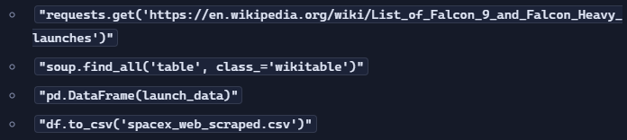
WEB SCRAPING with Beautifulsoup (bs4)
Purpose: Explain how additional launch data was scraped from Wikipedia.
Data Source: Wikipedia page on Falcon 9 launches.
Process Overview (Flowchart / Key Steps):
  Send HTTP Request → requests.get() to Wikipedia launch list page
  Parse HTML → Use BeautifulSoup to extract table elements
  Locate Launch Table → Identify <table> containing launch records
  Extract Rows → Iterate through <tr> elements for payload, date, site, outcome
  Clean Data → Strip whitespace, handle missing values
  Store Data → Convert into Pandas DataFrame
  Export → Save to CSV for wrangling and EDA
Key Phrases from Notebook:
GitHub Reference:
https://github.com/ritzdeee/IBM-Applied-Data-Science-Capstone-Project/tree/263918aab7e882a1fdb1cc9ba68e7e02be1e67ba/1.%20Data%20Collection

Slide 6
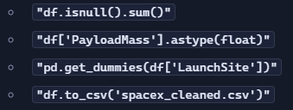
Data Wrangling Methodology
Showing how raw data from API and web scraping was cleaned, transformed, and prepared for analysis.
Issues
Missing values (NaNs) in payload mass and outcome fields
Inconsistent data types (strings vs. numeric)
Nested JSON structures requiring flattening
Duplicate records across API and scraped datasets
Process Overview (Flowchart / Key Steps)
Load Data → pd.read_csv() from API and scraped
CSVsHandle Missing Values → df.fillna() and df.dropna() for critical fields
Convert Data Types → Explicit astype(float) for payload mass
Normalize Categorical Fields → Encode launch site and orbit using pd.get_dummies()
Merge Datasets → Combine API and scraped data with pd.merge()
Final Dataset → Cleaned DataFrame ready for EDA and modeling
Notable Keyphrases
GitHub Reference:
https://github.com/ritzdeee/IBM-Applied-Data-Science-Capstone-Project/tree/263918aab7e882a1fdb1cc9ba68e7e02be1e67ba/2.%20Data%20Wrangling

Slide 7
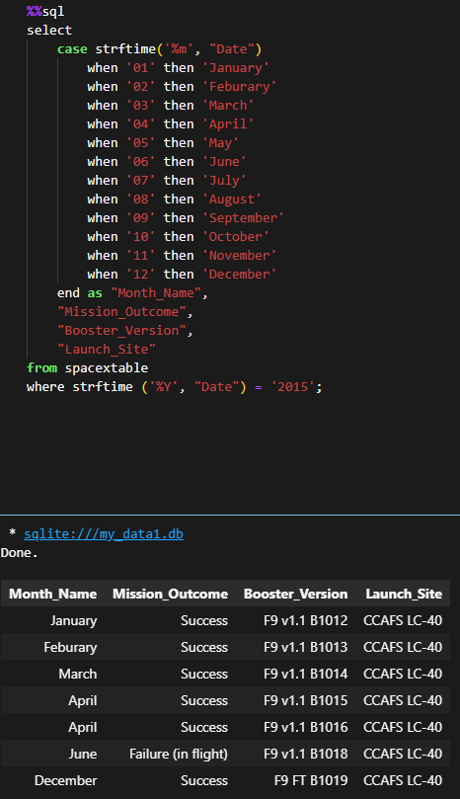
EDA with SQL
Use SQL queries to explore launch data and uncover patterns.
Queries Performed
Launch Site Analysis → Count launches per site
Payload Distribution → Average payload mass by orbit
Success Rates → Percentage of successful landings per site
Rankings → Identify top-performing launch sites
Timeline Analysis → Success trends across years
Purpose of SQL Analysis
Validate findings from Python visualizations with structured queries
Provide precise counts, averages, and percentages
Enable reproducible, query-driven insights
Key Findings
KSC LC-39A and CCAFS SLC-40 have higher success frequencies
Payloads in certain orbits (e.g., LEO) show better success rates
Success rates steadily improved after 2013
SQL confirms the same trends observed in Python EDA
Key Phrases from Notebook
"SELECT LaunchSite, COUNT(*) FROM spacex GROUP BY LaunchSite“
"SELECT Orbit, AVG(PayloadMass) FROM spacex GROUP BY Orbit“
"SELECT Year, SUM(Success)/COUNT(*) FROM spacex GROUP BY Year"
GitHub Reference:
https://github.com/ritzdeee/IBM-Applied-Data-Science-Capstone-Project/tree/263918aab7e882a1fdb1cc9ba68e7e02be1e67ba/3.%20EDA%20with%20SQL

Slide 8
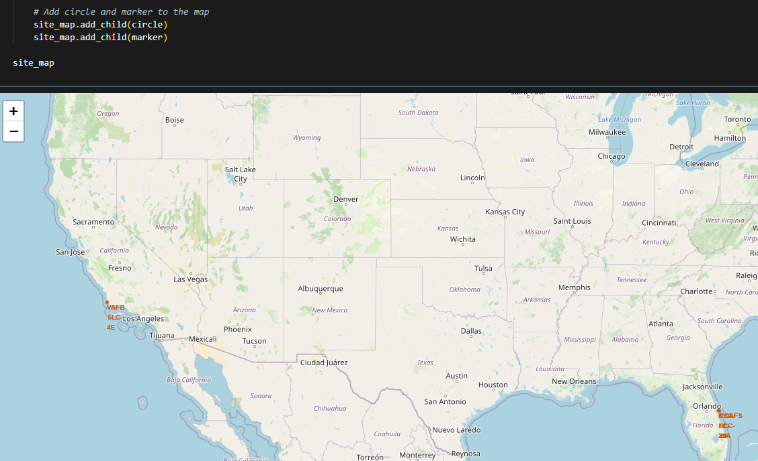
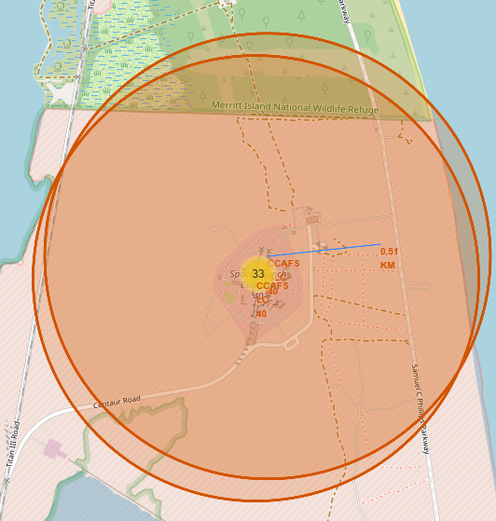
Interactive Visual Analytics
Folium Map
Plots launch site markers on a world map
Displays launch records with hover tooltips (site name, payload, outcome)
Proximity analysis: distance between launch sites and nearby facilities
Plotly Dash App
Success Pie Charts → Distribution of successful vs. failed landings by site
Payload vs. Outcome Scatter Plots → Interactive filtering by payload range and site
Dropdown filters for orbit type, launch site, and payload massReal-time updates of charts based on user selections
Purpose of Interactive Tools
Enable stakeholders to explore data dynamically
Provide intuitive visual insights into launch success patterns
Support decision-making with flexible, user-driven analysis
Key Phrases from Notebook
"folium.Marker(location=[lat, lon], popup=site)«
"dcc.Dropdown(options=[...], multi=True)“
"px.scatter(df, x='PayloadMass', y='Outcome', color='LaunchSite')"
GitHub Reference:
https://github.com/ritzdeee/IBM-Applied-Data-Science-Capstone-Project/tree/263918aab7e882a1fdb1cc9ba68e7e02be1e67ba/5.%20Interactive%20Visual%20Dashboarding

Slide 9
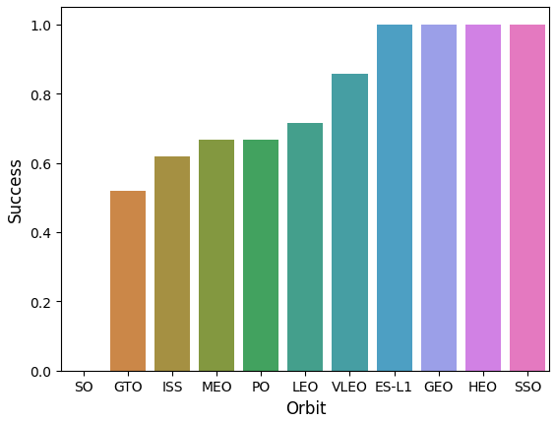
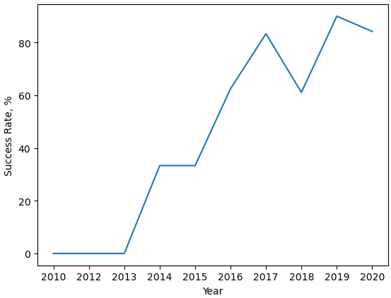
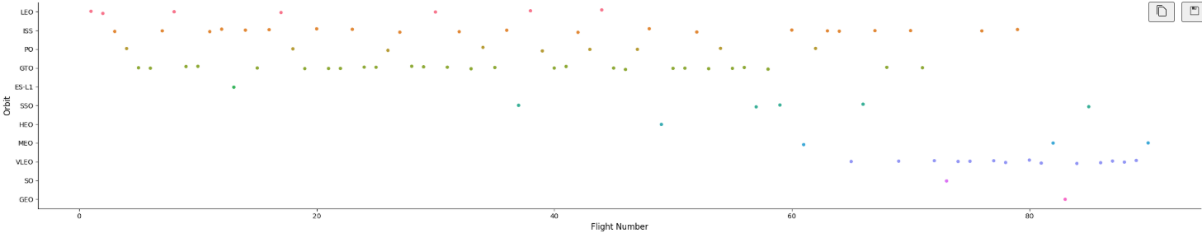
EDA Visualization Results visualizating outputs from exploratory analysis
Scatter Plots
Payload mass vs. landing outcome
Shows correlation: lighter payloads → higher success probability
Bar Charts
Success rates by launch site
Highlights site performance differences (KSC LC-39A consistently strong)
Yearly Trends (Line/Bar Charts)
Success rate progression across years
Clear upward trend in reliability since 2013
Key Findings
Payload mass and launch site are critical predictors of success
SpaceX’s success rate has steadily improved over time
Visual evidence supports the hypothesis that reusability drives reliability
Key Phrases from Notebook
"plt.scatter(df['PayloadMass'], df['Outcome’])”
"df.groupby('LaunchSite')['Outcome'].value_counts().plot(kind='bar’)”
"df['Year'].value_counts().plot(kind='line')"

Slide 10
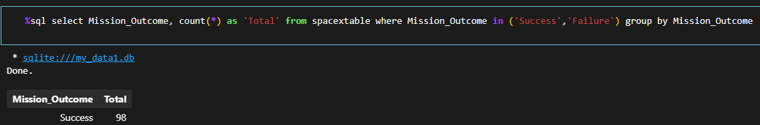
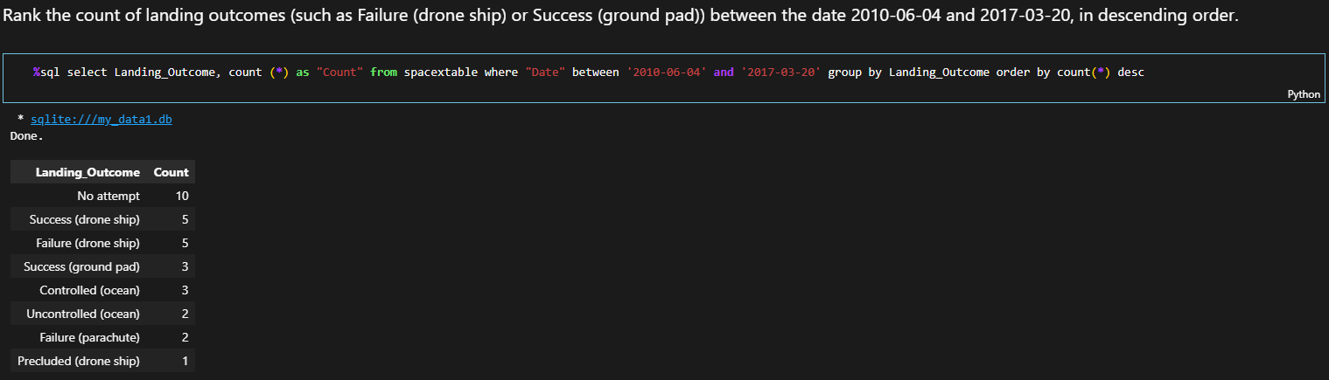
EDA with SQL Results
Timeline Analysis
Query: SELECT Year, SUM(Success)/COUNT(*) FROM spacex GROUP BY Year
Result: Success rates steadily improved after 2013, reaching >90% in recent years.
Key Findings
SQL confirms payload mass and launch site as critical predictors.
Structured queries validate trends observed in Python visualizations.
Timeline analysis highlights SpaceX’s growing reliability.
Launch Site Analysis
Query: SELECT LaunchSite, COUNT(*) FROM spacex GROUP BY LaunchSite
Result: KSC LC-39A and CCAFS SLC-40 show the highest number of launches
Payload Distribution
Query: SELECT Orbit, AVG(PayloadMass) FROM spacex GROUP BY Orbit
Result: LEO payloads average lower mass, correlating with higher success rates.
Success Rates by Site
Query: SELECT LaunchSite, SUM(Success)/COUNT(*) FROM spacex GROUP BY LaunchSite
Result: KSC LC-39A has the highest success percentage.
Rankings
Query: SELECT LaunchSite, COUNT(Success) AS SuccessfulLandings FROM spacex GROUP BY LaunchSite ORDER BY SuccessfulLandings DESC
Result: Ranked list confirms LC-39A as top-performing site.

Slide 11
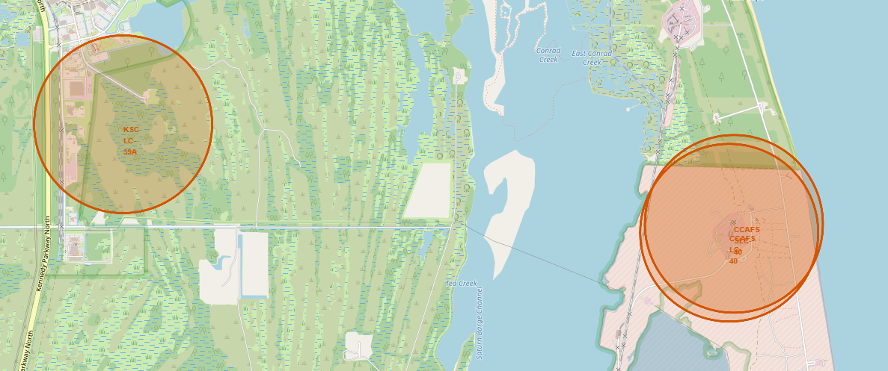
Folium Map Results
Launch Site Markers
Each launch site plotted on a Folium map with latitude/longitude coordinates
Popups display site name, payload, and launch outcome
Launch Records
Interactive markers allow exploration of individual launch details.
Provides spatial perspective on where launches occur
Proximity Analysis
Calculated distances between launch sites and nearby facilities (e.g., airports, coastlines).
Helps assess logistical advantages of site locations
Key Phrases from Notebook
"folium.Map(location=[28.5, -80.5], zoom_start=5)“
"folium.Marker([lat, lon], popup=site_name)“
"folium.CircleMarker(..., radius=5, color='blue')""geopy.distance.distance(site, facility).km“
Key Findings
Launch sites are strategically located near coastlines for safety.
Proximity to infrastructure supports operational efficiency.
Folium maps provide intuitive geographic insights beyond tabular data.

Slide 12
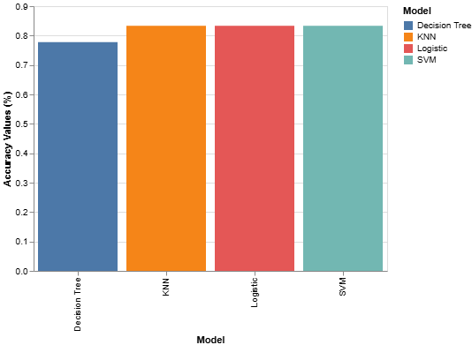
Predictive Analysis Results
Models Applied
Logistic Regression
Support Vector Machine (SVM)
K-Nearest Neighbors (KNN)
Decision Tree
Evaluation Metrics
Accuracy scores across models
Confusion matrices for classification performance
Precision, recall, and F1-score comparisons
Results
Logistic Regression achieved balanced accuracy and interpretability
SVM performed well but required more tuning
KNN showed moderate accuracy, sensitive to parameter choice
Decision Tree provided clear rules but risked overfitting
Best Model
Logistic Regression selected as optimal model
Offers strong predictive accuracy with explainable coefficients
Confirms payload mass and launch site as key predictors
Conclusion
Predictive modeling validates EDA findings: payload and site drive success probability
Models demonstrate SpaceX’s increasing reliability over time
Insights can guide competitive strategy and cost-saving decisions in commercial launches
Key Phrases from Notebook
"LogisticRegression().fit(X_train, y_train)“
"confusion_matrix(y_test, y_pred)“
"classification_report(y_test, y_pred)“
"classification_report(y_test, y_pred)"

Slide 13
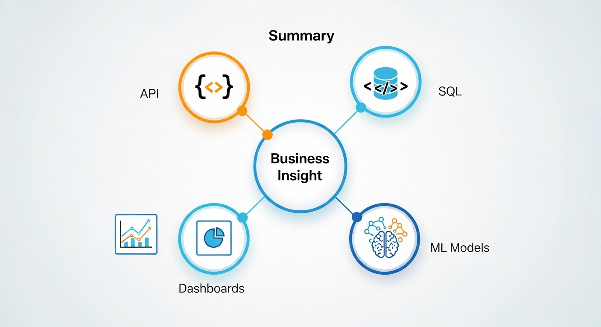
Conclusion & Insights
Project Outcomes
Successfully collected and integrated SpaceX launch data via API and web scraping.
Cleaned and wrangled data into a reliable dataset.
Conducted EDA with Python visualizations and SQL queries to uncover trends.
Built interactive dashboards (Folium, Plotly Dash) for dynamic exploration.
Applied multiple machine learning models to predict landing success.
Key Results
Logistic Regression identified as the best-performing model.
Payload mass and launch site are the strongest predictors of success.
Success rates have steadily improved since 2013, confirming SpaceX’s growing reliability.
Creative & Innovative Insights
Combining geospatial analysis (Folium) with predictive modeling provides a holistic view of launch success.
Interactive dashboards empower stakeholders to explore data intuitively.
Predictive analytics can guide strategic decisions in commercial spaceflight, reducing costs and improving competitiveness.
Final Takeaway
Data-driven insights confirm SpaceX’s reusability strategy is effective.
Predictive modeling offers a powerful tool for forecasting future launch outcomes.
The project demonstrates how applied data science can bridge technical analysis with real-world business impact.

Slide 14
THANK YOU
Richard Ho

